Slide 1
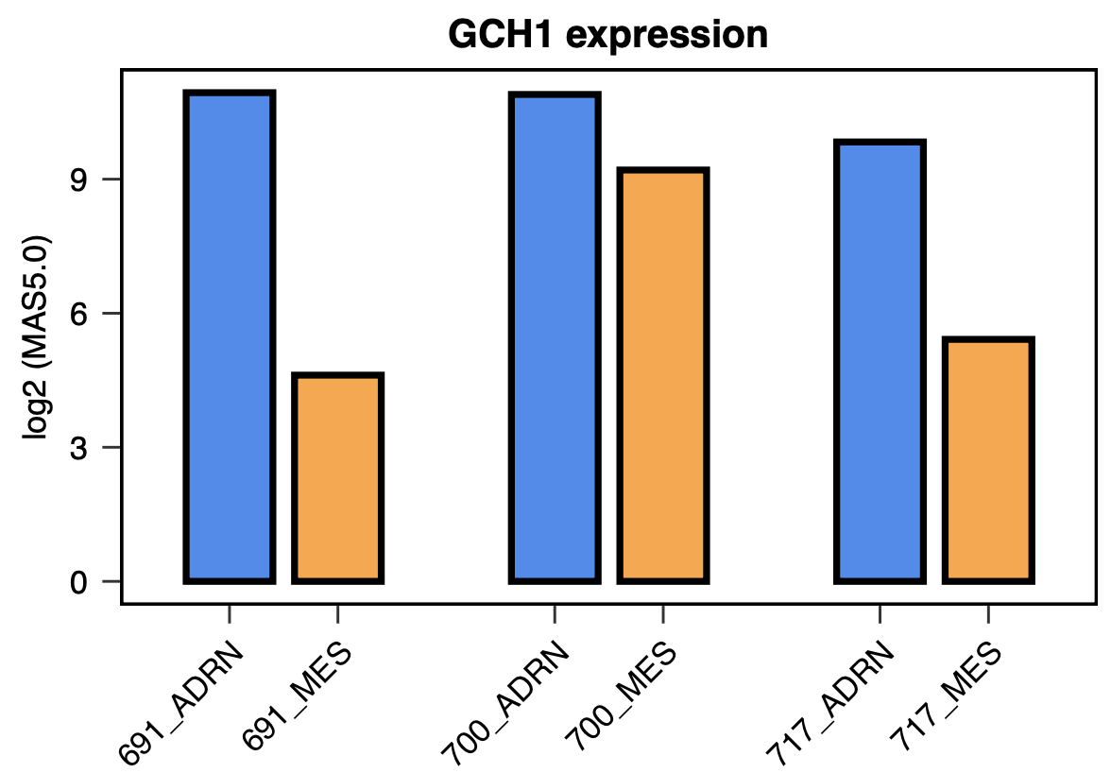
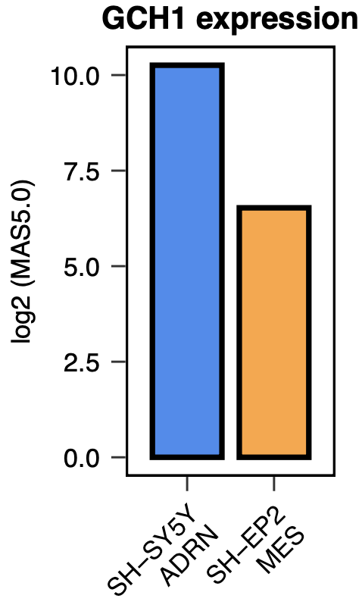
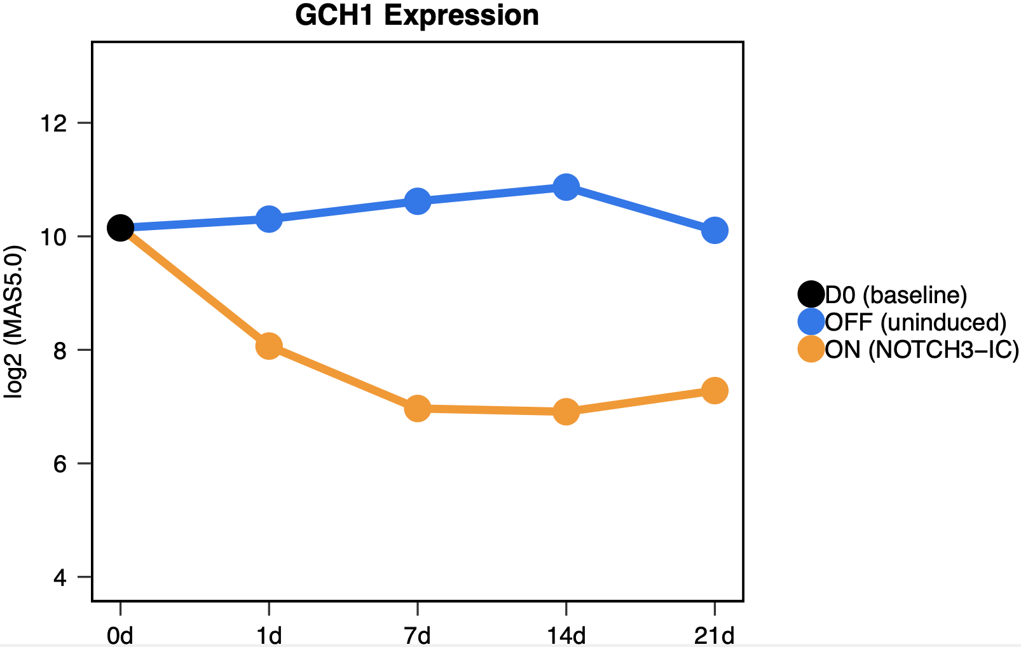
Extended data Fig. 4
a
b
c
CD133+/- cell line pairs
Subclonal
SK-N-SH
NOTCH3-IC SH-SY5Y
time-course

